Slide 1
Present Perfect
Intermediate 1 – Unit 3b

Slide 2
Structure
I
You
He
She
It
We
You
They
have
have
has
has
has
have
have
have
gone
done
studied
arrived
been
eaten
delivered
analysed
S + have/has + past participle

Slide 3
Short form
I’ve gone home.
You’ve done a lot of homework.
She’s studied French.
He’s investigated.
They’ve operated on an old lady.

Slide 4

Use 1
Something that started in the past and continues until now.
I have studied in this university for a year.
Dr Jones has worked here since 1999.

Slide 5
Key words for present perfect
Since and for
Since + specific point in the past when the action started
For + duration, length of time

Slide 6

Use 2
Event that happened in the past, but we don’t know when, or it’s not important when.
I have been to India many times.
She has visited Africa and Asia.
They have eaten insects.

Slide 7
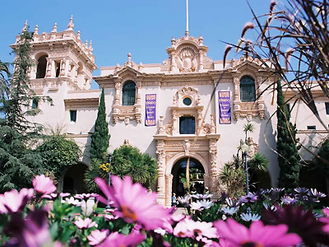
Use 3
Repeated past action (could happen again)
Examples:
-Juanita has gone to Balboa Park many times.
-I’ve flown on a plane a lot.

Slide 8

Use 4
When we talk about experiences we have had in life
Examples:
-Have you been to China?
Yes, I have, and I would love to go again.

Slide 9
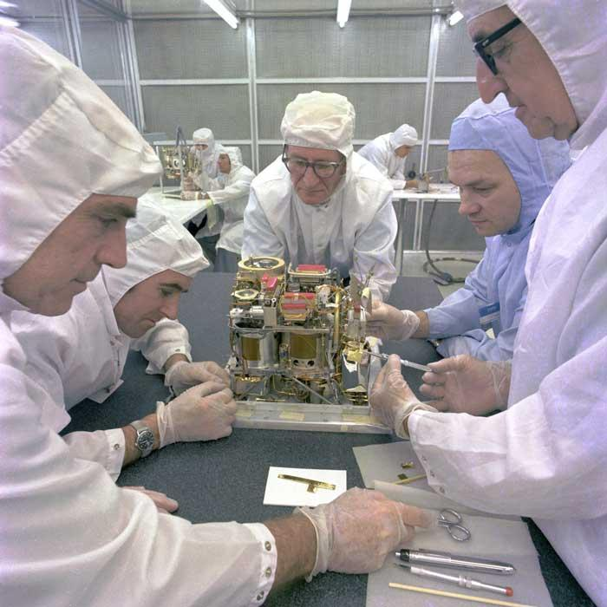

Key words for present perfect
Already = (adv.) before now
I have already finished my homework.
Not … yet = (adv.) not before now
Scientists have not discovered a cure yet.

Slide 10
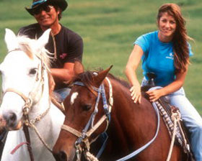
Key words for present perfect
Ever = (adv.) at any time, including the present
** Used only in questions
Have you ever ridden a horse?

Slide 11
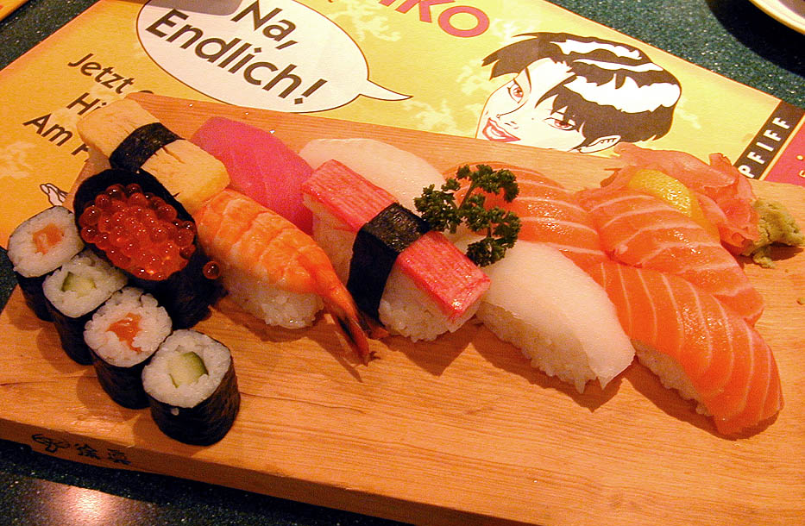
Reminder about Adverb Placement
With 2 verbs (helping verb and main verb), place the adverb between them. Except “yet” which goes at the end of the sentence.
I have never eaten sushi.

Slide 12
Negative form
I
You
He
She
It
We
You
They
have
have
has
has
has
have
have
have
not
not
not
not
not
not
not
not
gone
done
studied
arrived
been
eaten
delivered
analysed
S + haven’t/hasn’t + past participle

Slide 13
Examples
She hasn’t arrived yet.
They haven’t discovered the cure.

Slide 14
Yes/No Questions
?
You
have
you
finished
He
has
he
studied a lot
?

Slide 15
Answer: Yes, I have or No, I haven’t
Have you ever visited Peru?
Have you ever eaten octopus?
Have you ever drunk rum?
Has your mother ever been to Argentina?
Have your teachers ever told a joke?
Have you seen a teacher in the street?
Have you ever saved a life?

Slide 16
- What tense are these sentences? - Transform them into Present perfect sentences.
1) I studied a lot yesterday. (Past Simple)
2) Dr House arrived at the building.
3) The resident started his presentation
an hour ago.
4) Dr Jones operated on two hearts yesterday.
5) Celina Perez always works very hard.
I’ve studied a lot.
(past)
(past)
(past)
(present)

